Slide 1
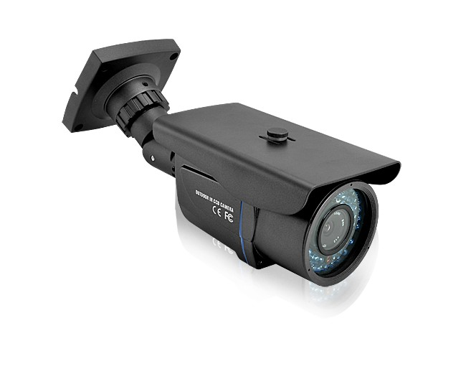
Installing goverment-controlled cameras
This is my first presentation
Notes:
Install goverment controlled cameras
Today I’m going to talk about an important topic: installing geoverment-controlled cameras.

Slide 2

In law
Today I would like to talk about a law suggestion
Notes:
Cameras should be installed everywhere
Get rid of dangerous areas in city

Slide 3
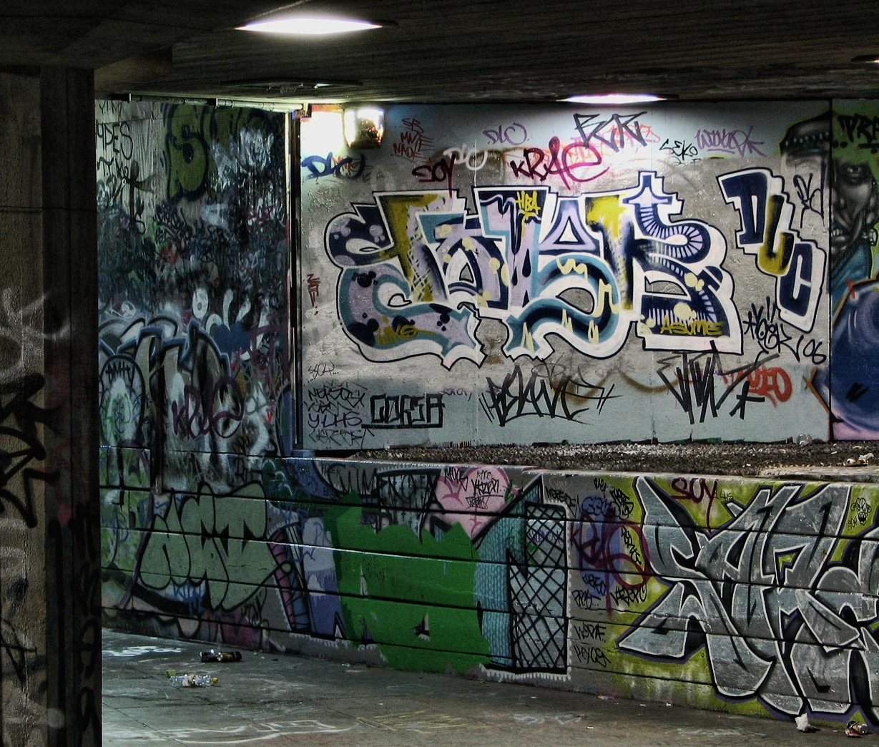
No criminal areas
Lots of people living in criminal areas
People aren’t willing to go out
The gun-shooting at apartment in Vinsta
Notes:
Nothing is going to be rural

Slide 4
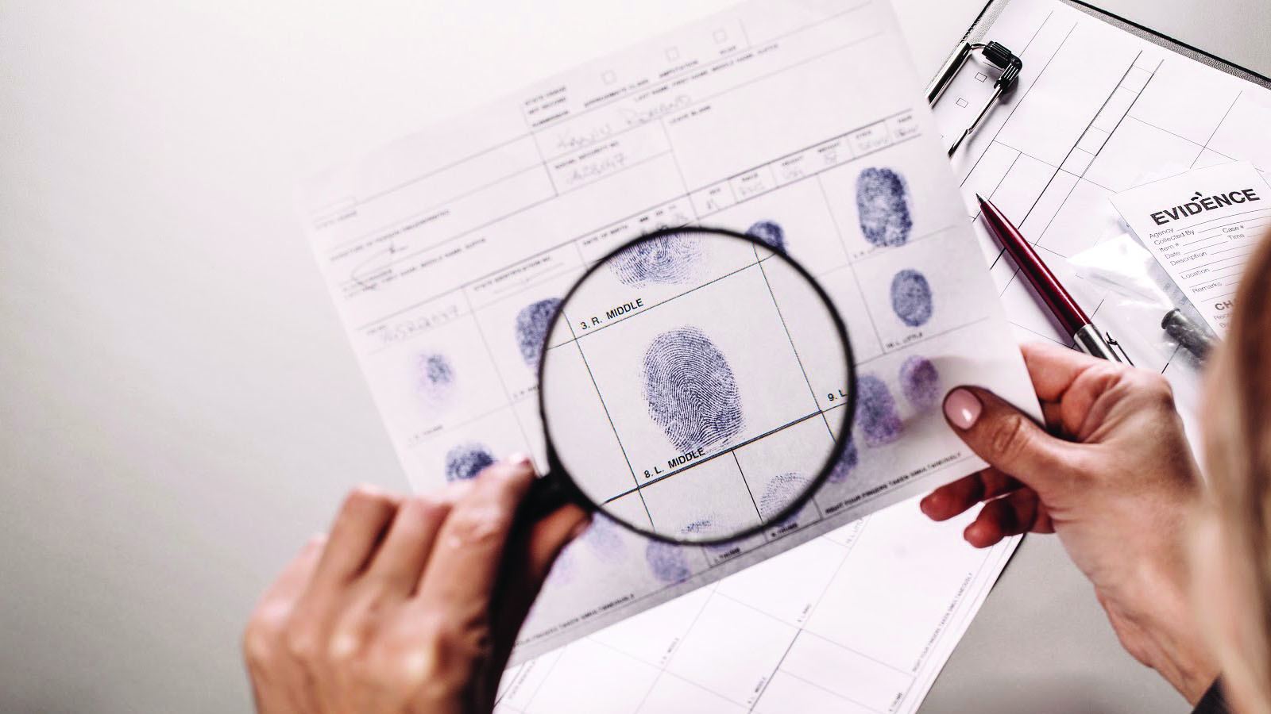
Solving criminal cases easily
Police can solve criminal cases faster and easier
Camera recording will be the most effeciency evidence
No one would do criminal-related things
Notes:
This can be done faster, not in the picture

Slide 5
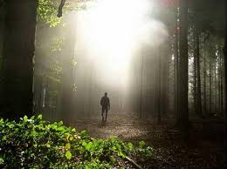
Finding lost people
Today no one knows where the missing people are
Organisation spending a lot of money to find them
Watching recording could track where the missing people is going

Slide 6

Counter argument: high-cost
It’s still worth
The effeciency is high
The cost for police department is higher today than the cameras

Slide 7
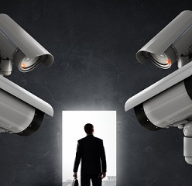
Counter argument: insecure feeling
Probably having insecure with cameras
Can prevent crimes happening

Slide 8

Storing big data
Need a big database
High cost and too big
Overflow
Future possibilities
Notes:
We should have a big database but with high cost.

Slide 9
future
possibilities
´greater things
Notes:
I got a big fail!

Slide 10
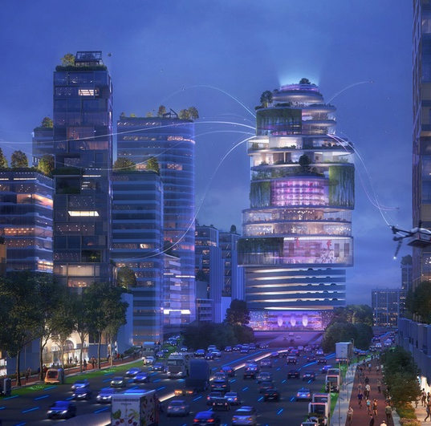
Future
There should be no crimes
Notes:
Despite the millenial bug team’s best efforts, the two zeros remained but unrecognized. It is in history but happening will repeat.

